Slide 1


An Overview of Bulma Framework
What is Bulma?
Bulma is a free, open source CSS framework based on Flexbox and used by more than 200,000 developers

Slide 2
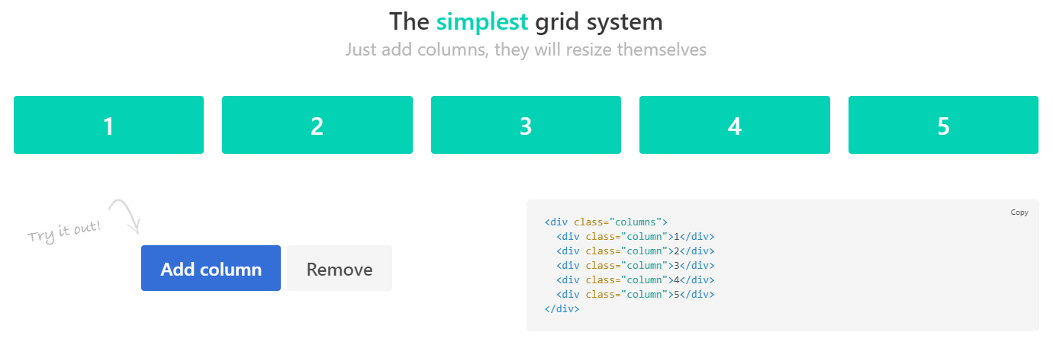

Slide 3
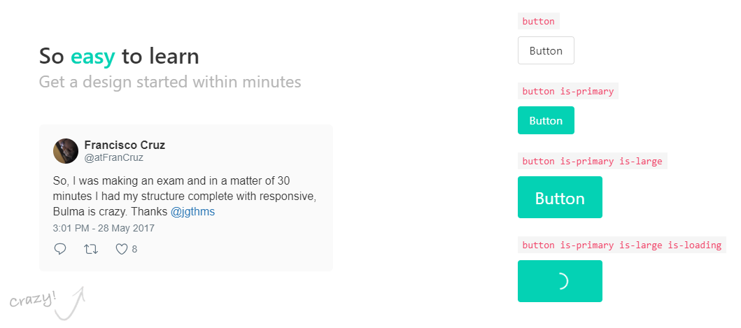

Slide 4

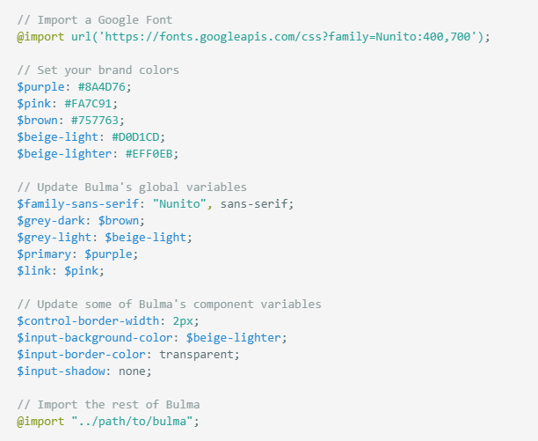
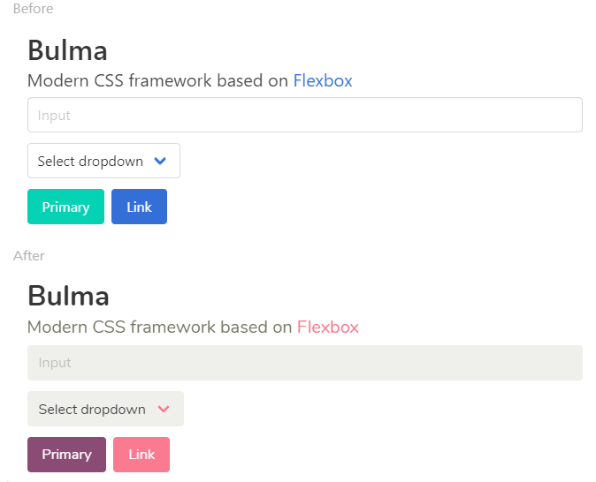

Slide 5


Slide 6


Slide 7
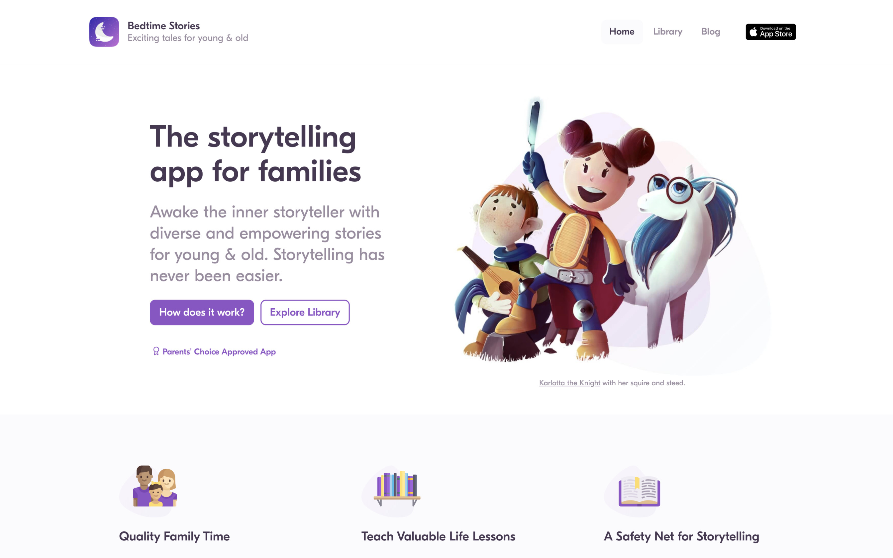

Slide 8
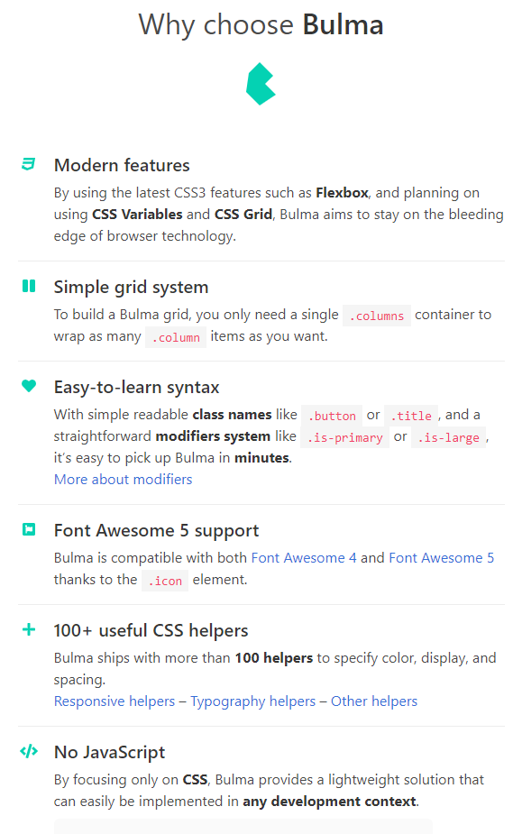

Slide 9
Here are a few reasons why Bulma is different than other CSS frameworks:
Modern: All of Bulma is based on CSS Flexbox. A simple way to build responsive columns.
100% responsive: Bulma is designed to be both mobile and desktop friendly. Design for a mobile-first. Every element in Bulma is mobile-first and optimizes for vertical reading, so by default on mobile:
columns are stacked vertically
the level component will show its children stacked vertically
the nav menu will be hidden
Modularity: Bulma consists of 39 .sass files that you can import individually. Just import what you need.
Easy to learn: Most users get started within minutes
Simple syntax: Bulma makes sure to use the minimal HTML required, so your code is easy to read and write
Customizable: With over 300 SASS variables, you can apply your own branding to Bulma
No JavaScript: Because Bulma is CSS-only, it integrates gracefully with any JavaScript framework (Angular, VueJS, React, or just plain Vanilla JavaScript)

